Slide 1
Wrapper Scenario

Slide 2
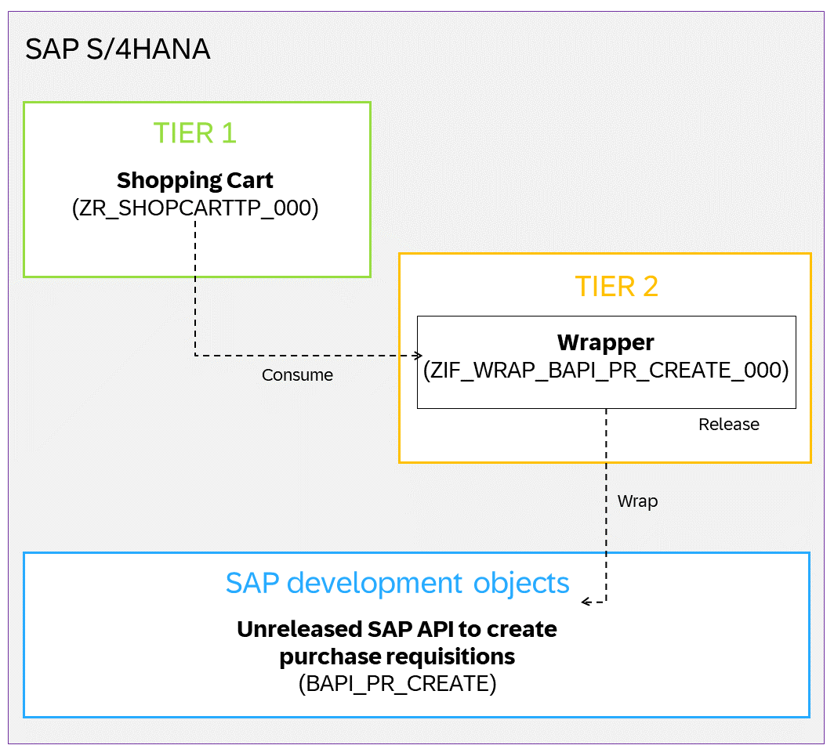
Wrapper Scenario
How to wrap the BAPI_PR_CREATE in your SAP S/4HANA system and release it for consumption in tier 1.

Slide 3
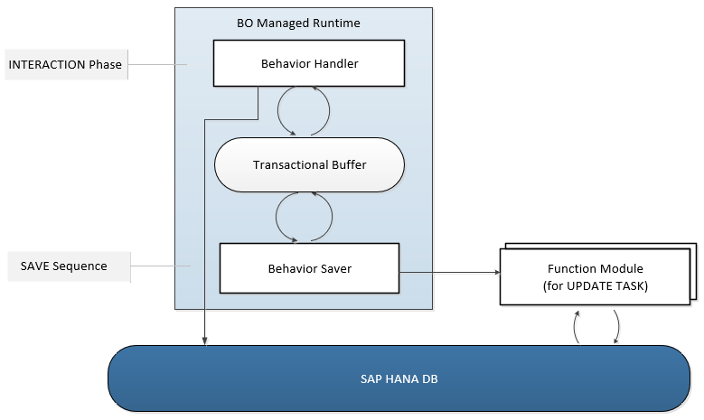
Runtime for the Managed Business Objects with Unmanaged Save

Slide 4
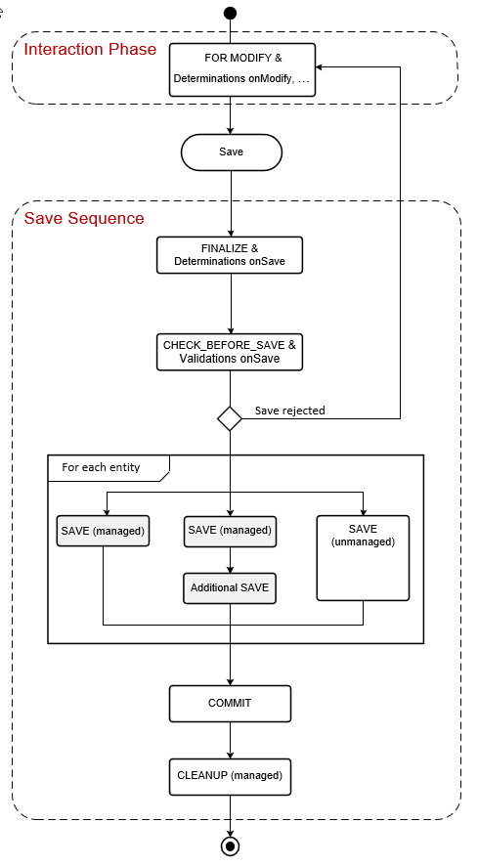
Unmanaged Save within the Transactional Processing

Slide 5
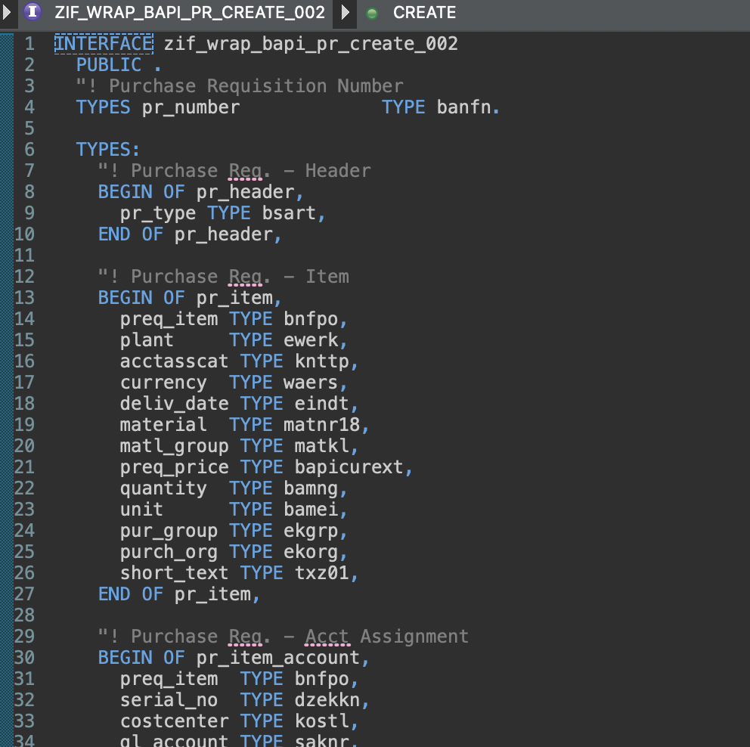
Create Interface (local)

Slide 6
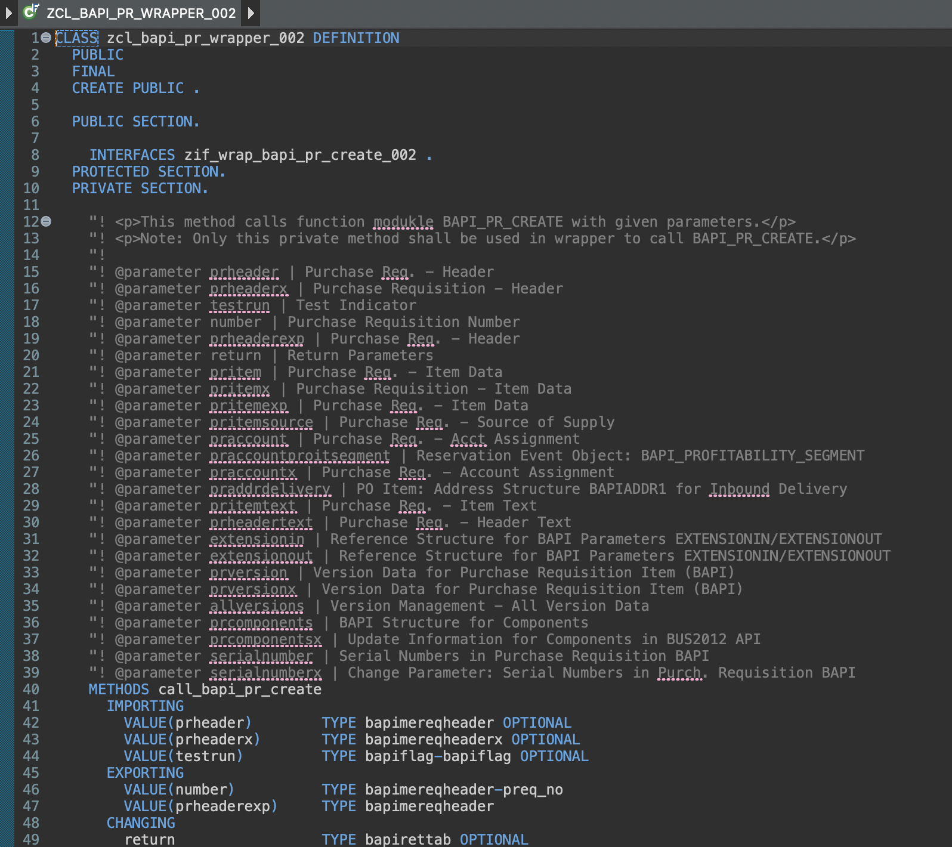
Create Wrapper class

Slide 7
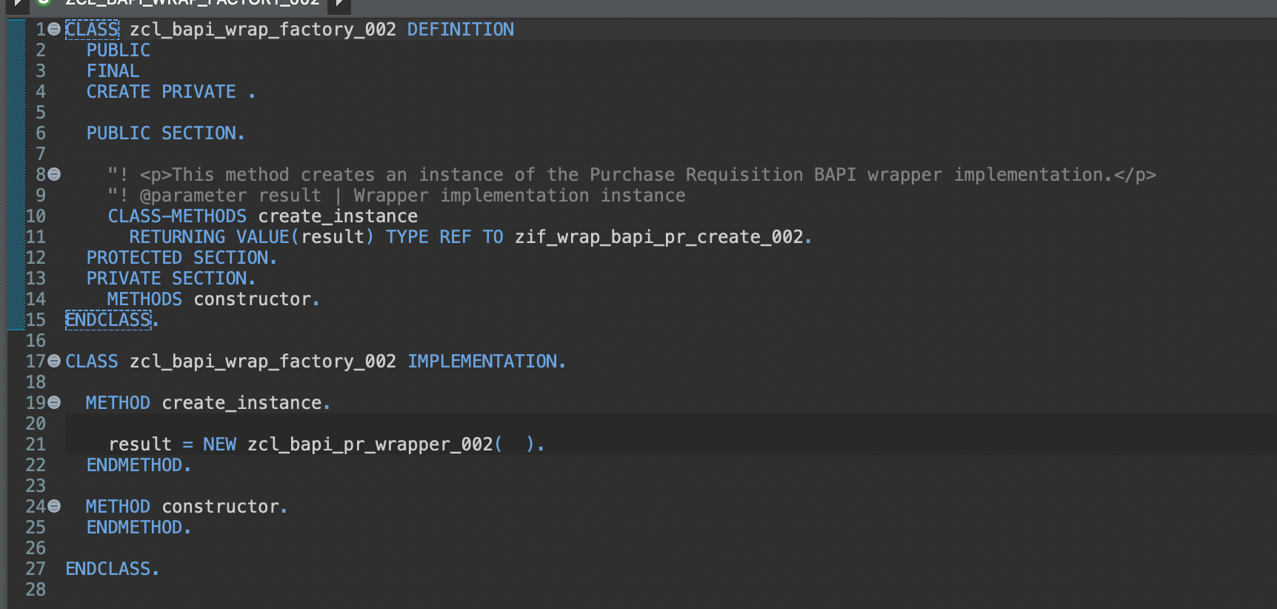
Create Wrapper factory class

Slide 8
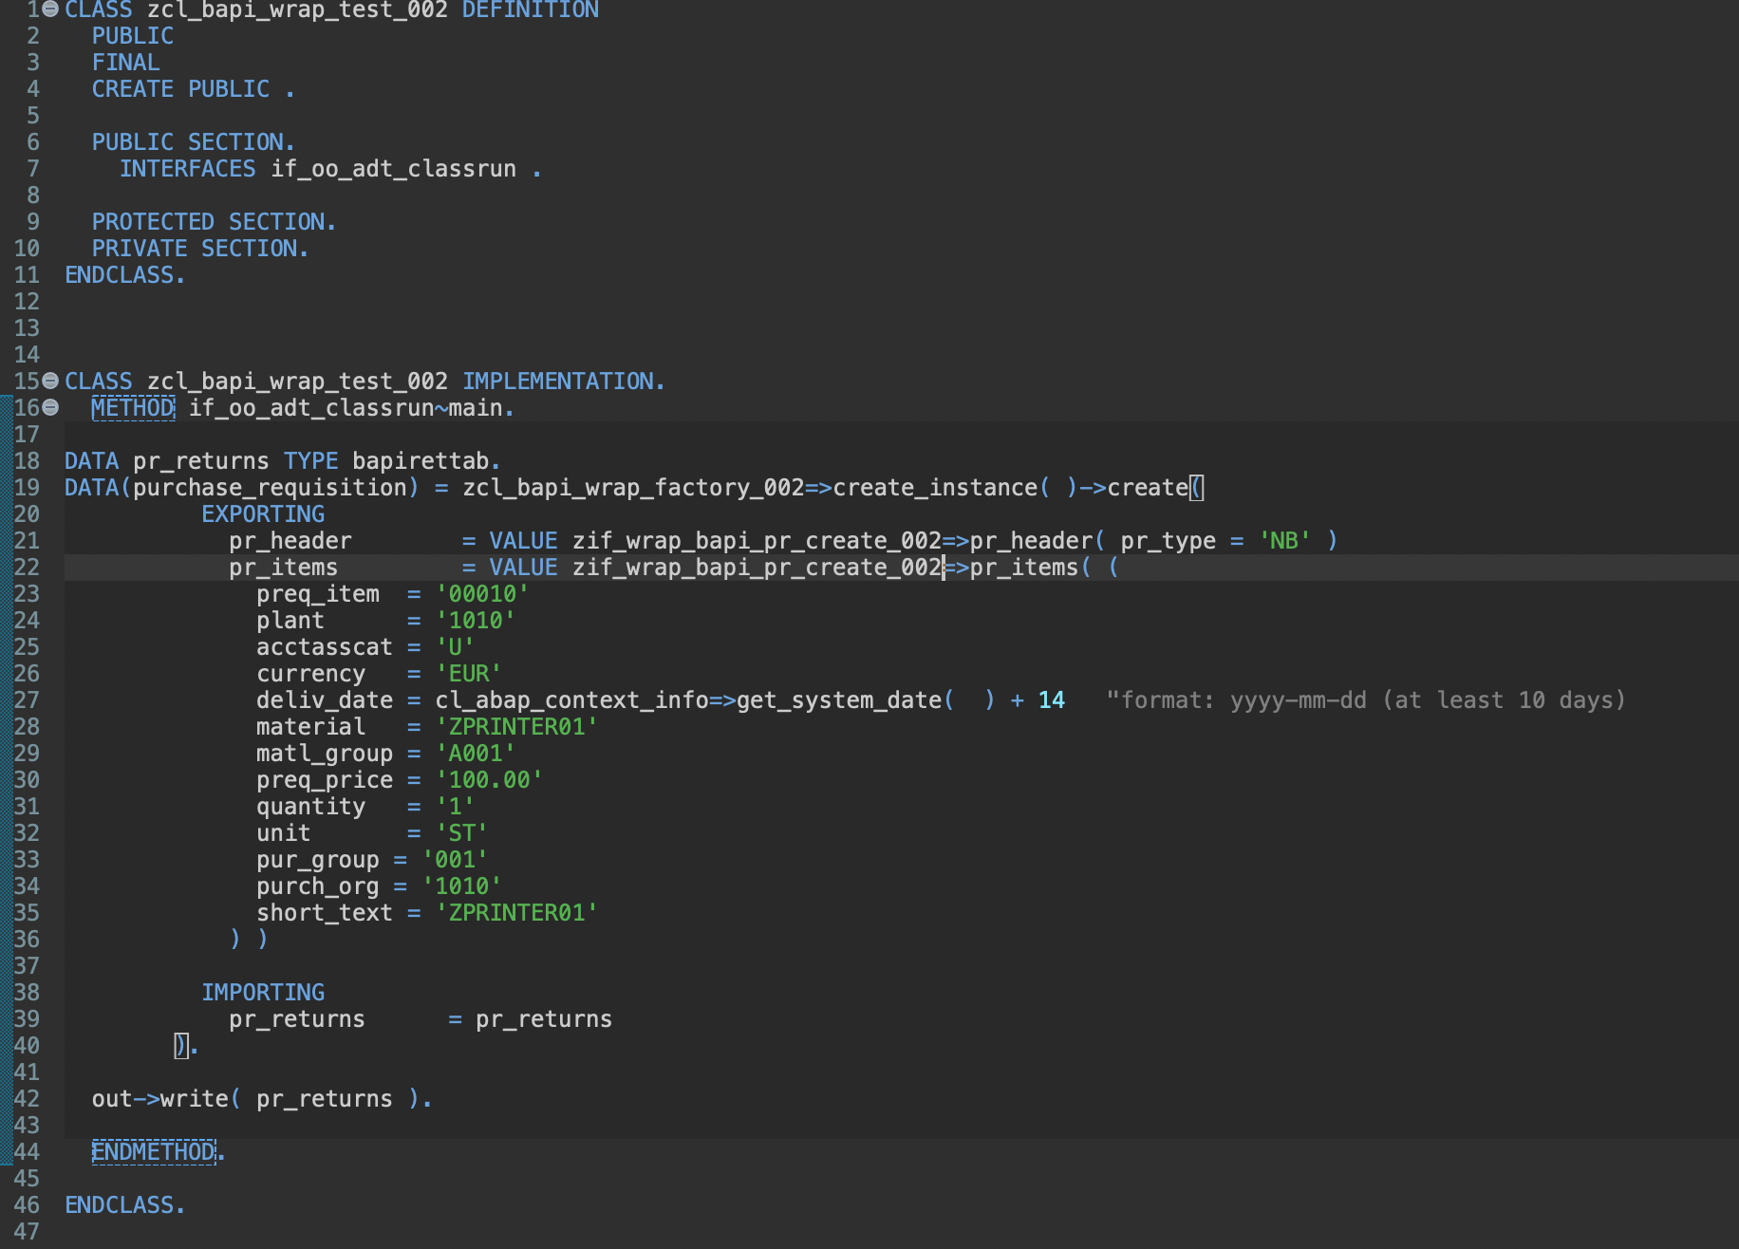
Implement Test Class
Set correct values (search with I_PurchaseRequisition / I_PRODUCT...)

Slide 9
Together
Set Release State and option “Use in Cloud Development“.

Slide 10
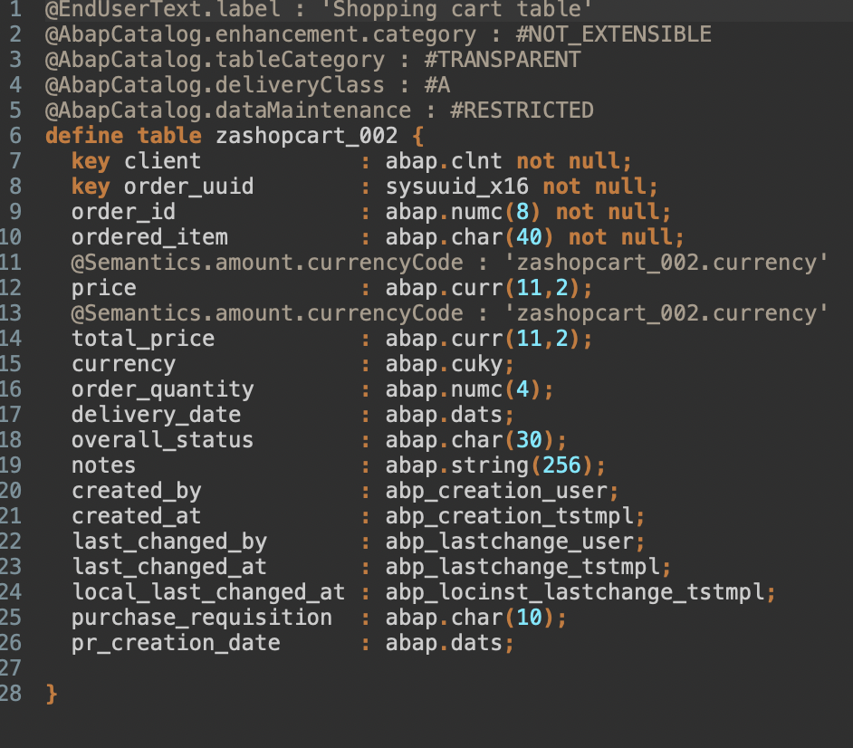
Create DB Table

Slide 11
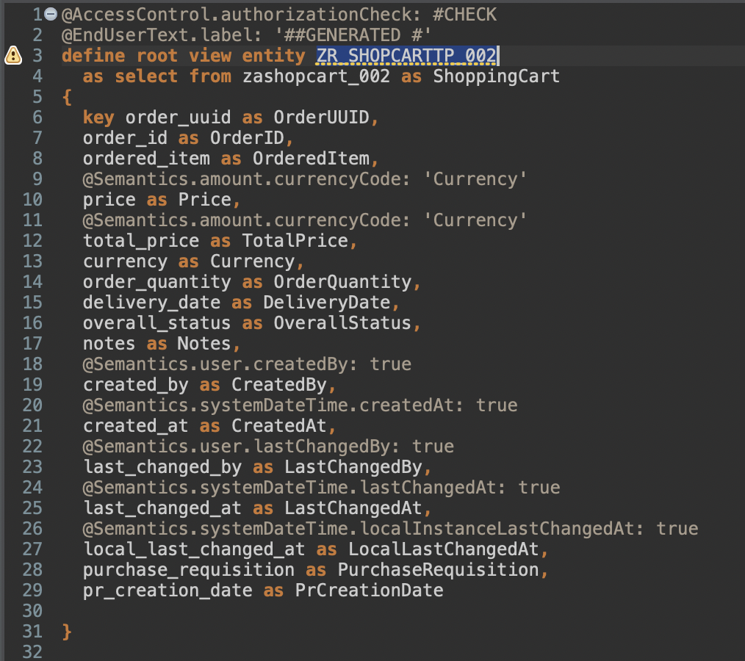
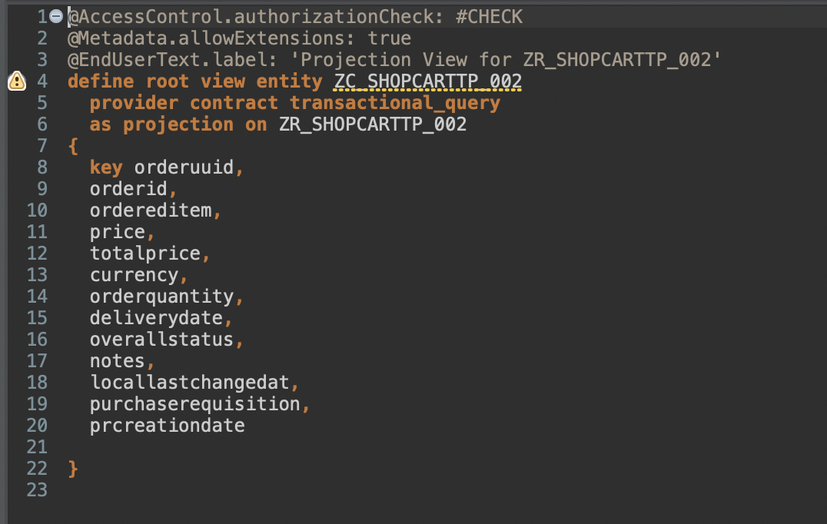
Create Views

Slide 12
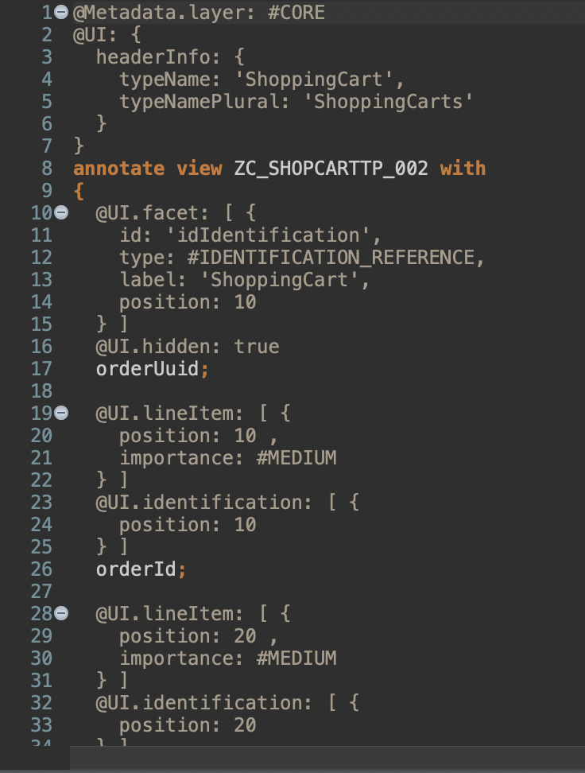
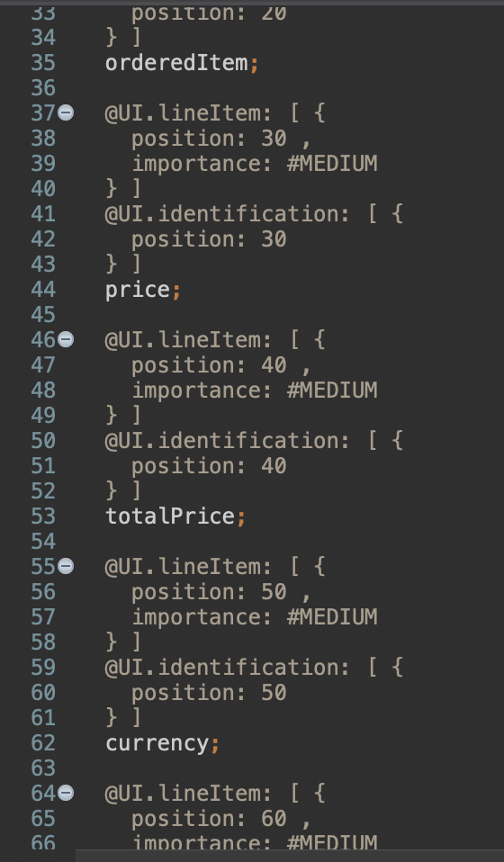
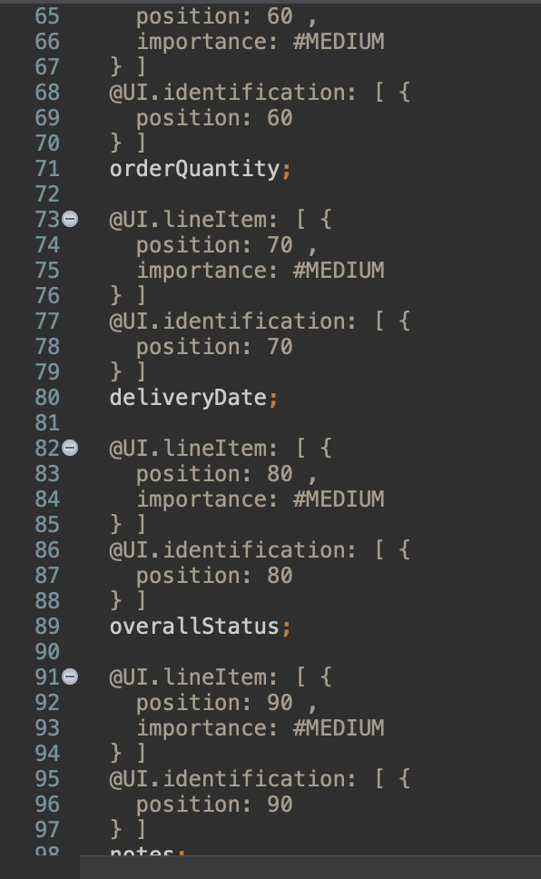
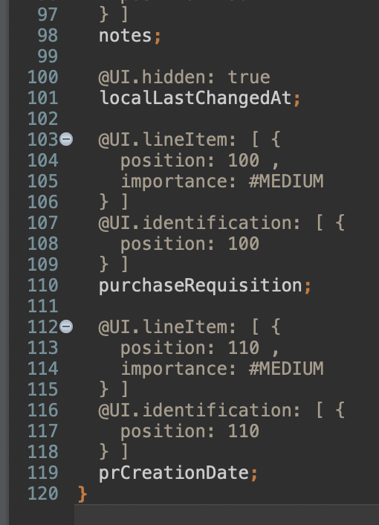
Create Metadata Extension

Slide 13
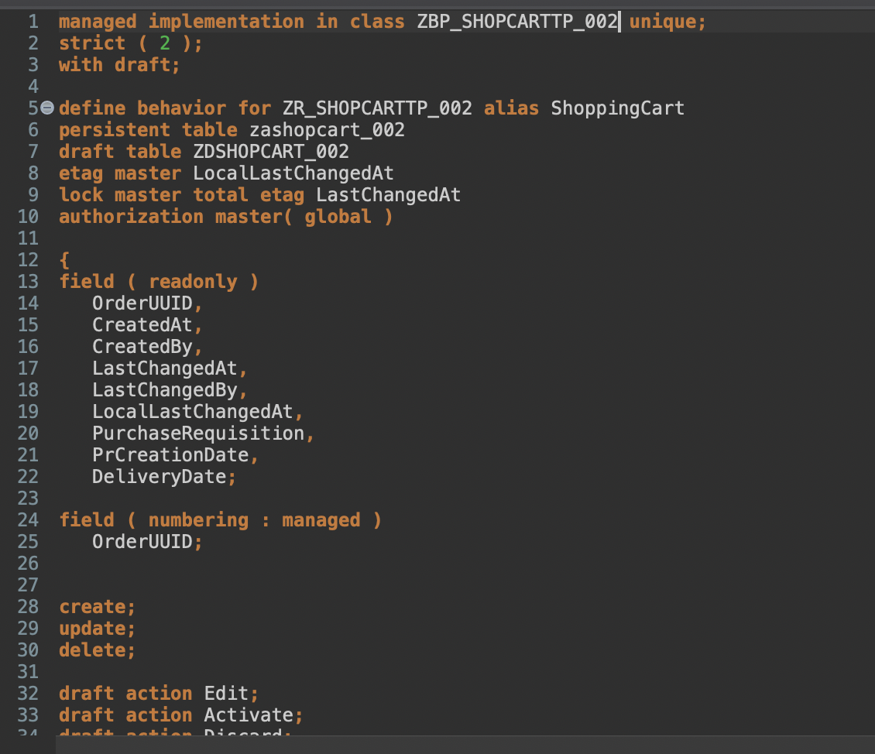
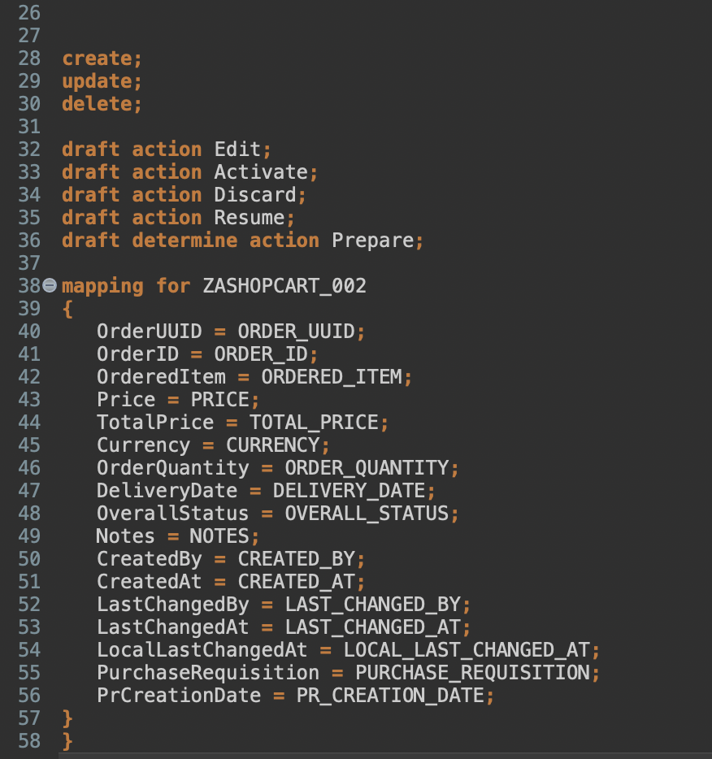
Enhance Behavior Definition

Slide 14
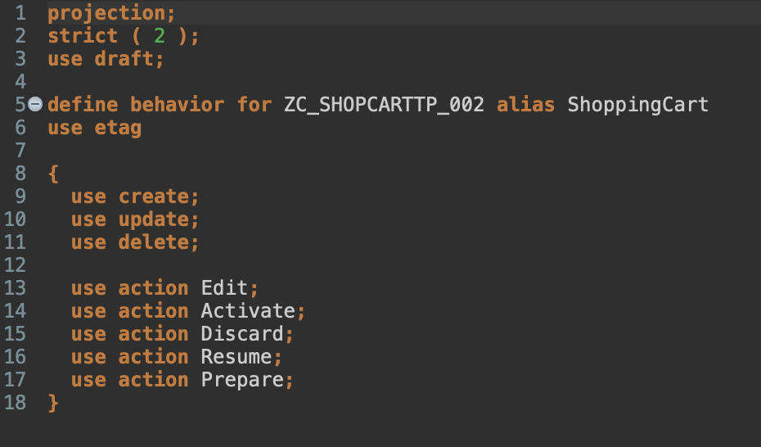
Create Behavior Projection

Slide 15
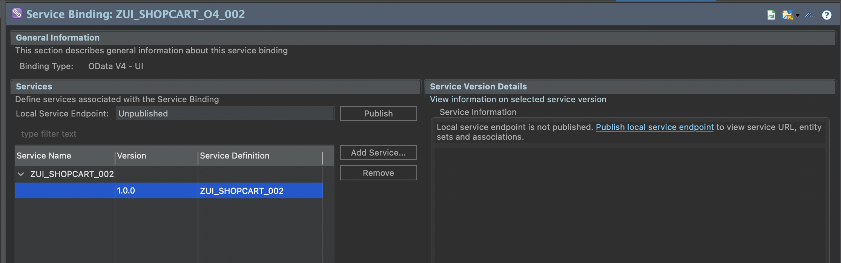
Publish service binding and run SAP Fiori Elements preview
/IWFND/V4_ADMIN

Slide 16
Test it
If metadata information is missing, then add it.

Slide 17
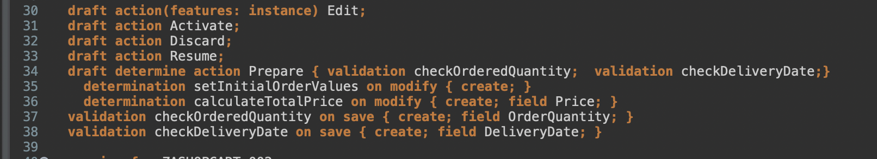
Enhance behavior definition of data model

Slide 18
Create data definition for products
Create a Value Help ZI_PRODUCTS_### for Product as select from I_Product.
Fields
Product
Price
Currency
ProductGroup
BaseUnit

Slide 19
Enhance Metadata
@Consumption.valueHelpDefinition: [{ entity: {name: 'ZI_PRODUCTS_###' , element: 'ProductText' }, additionalBinding: [{ localElement: 'price', element: 'Price', usage: #RESULT }, { localElement: 'currency', element: 'Currency', usage: #RESULT } ] }]
Annotation for field ordereditem;

Slide 20
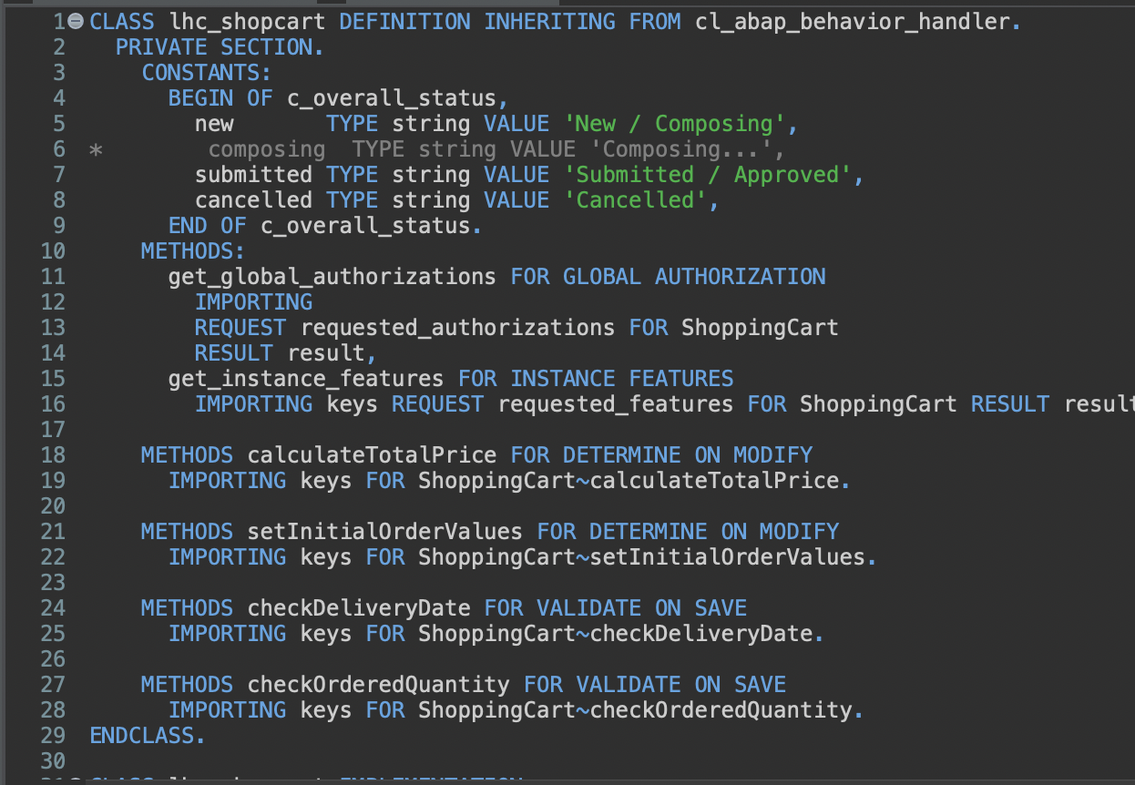
Enhance behavior implementation

Slide 21
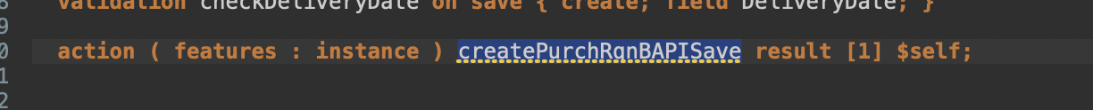
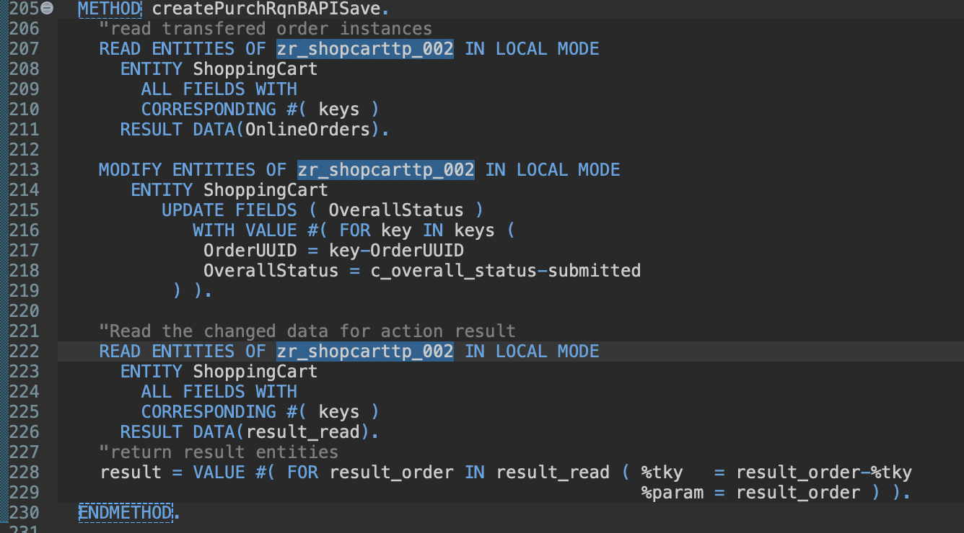
Implement new action createPurchRqnBAPISave

Slide 22
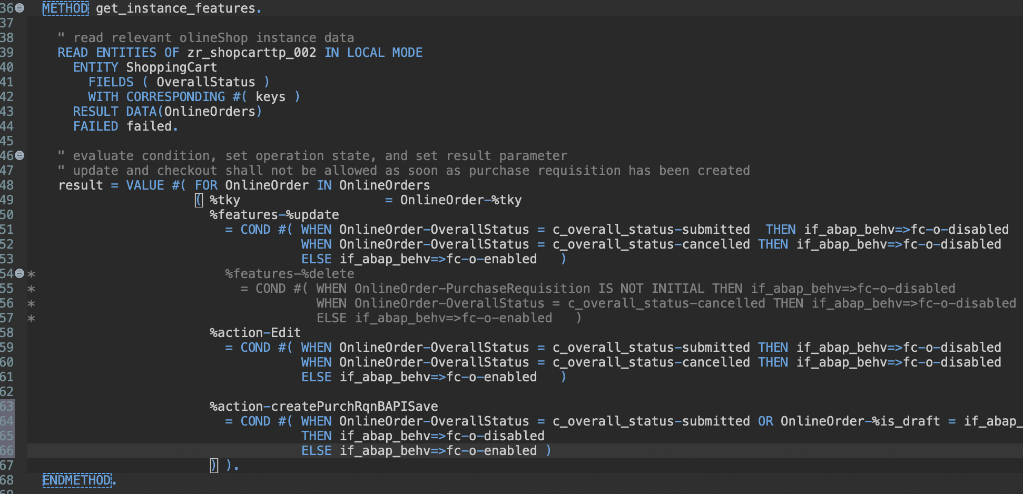
Implement new action createPurchRqnBAPISave
Change get_instance_features wit createPurchRqnBAPISave

Slide 23

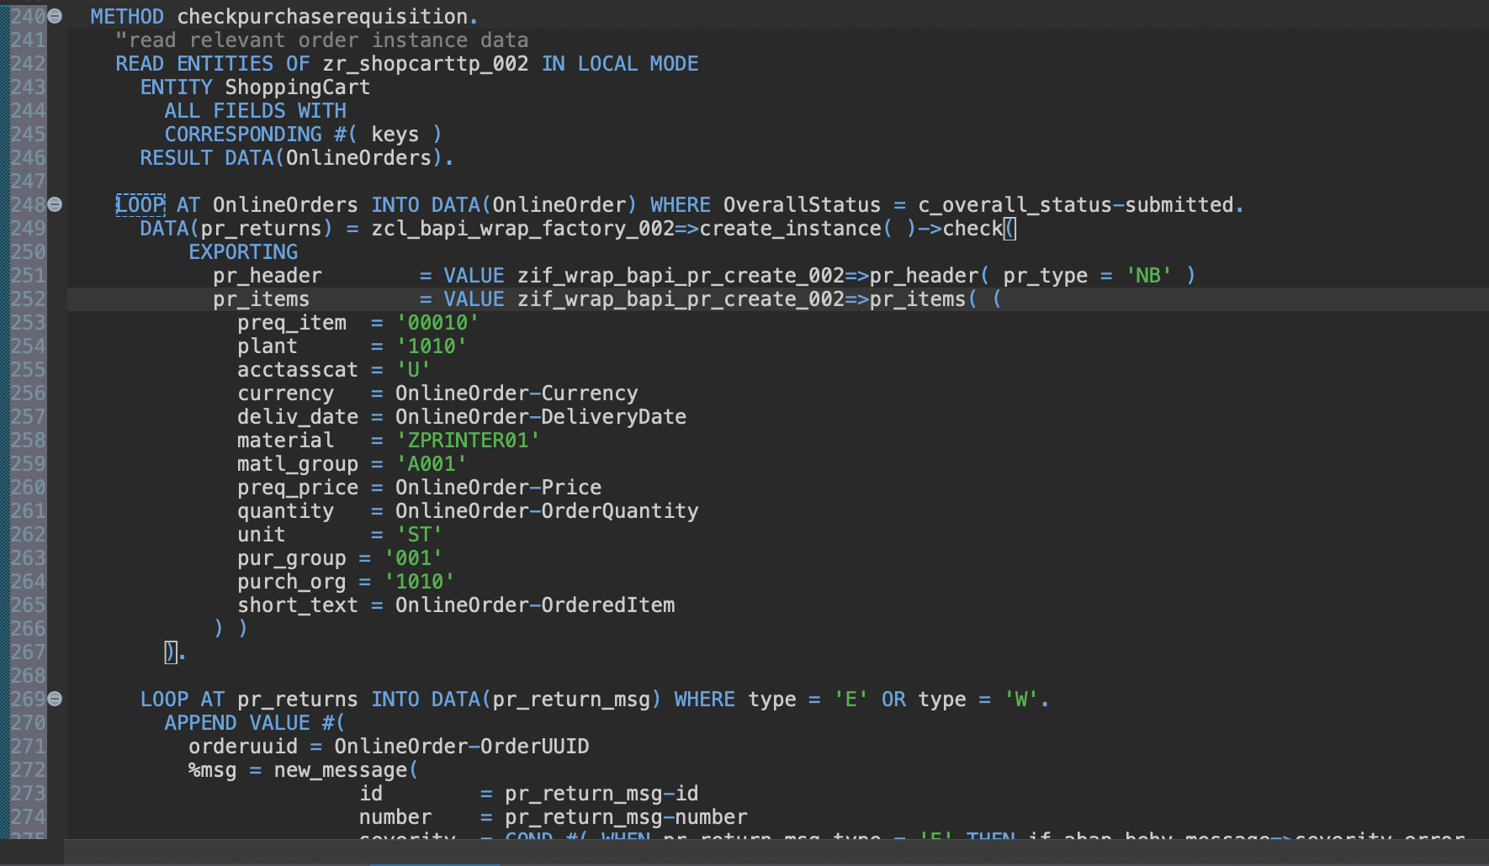
Implement on save validation using the BAPI test mode

Slide 24
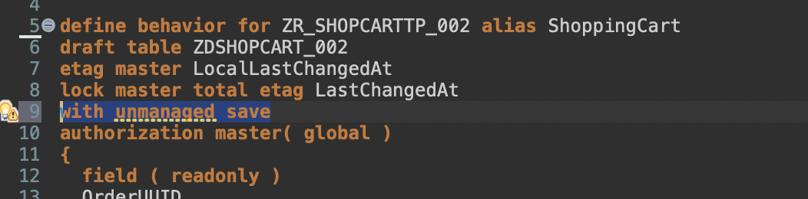
Implement unmanaged save
Add with unmanaged save
Delete persistent table zashopcart_002

Slide 25
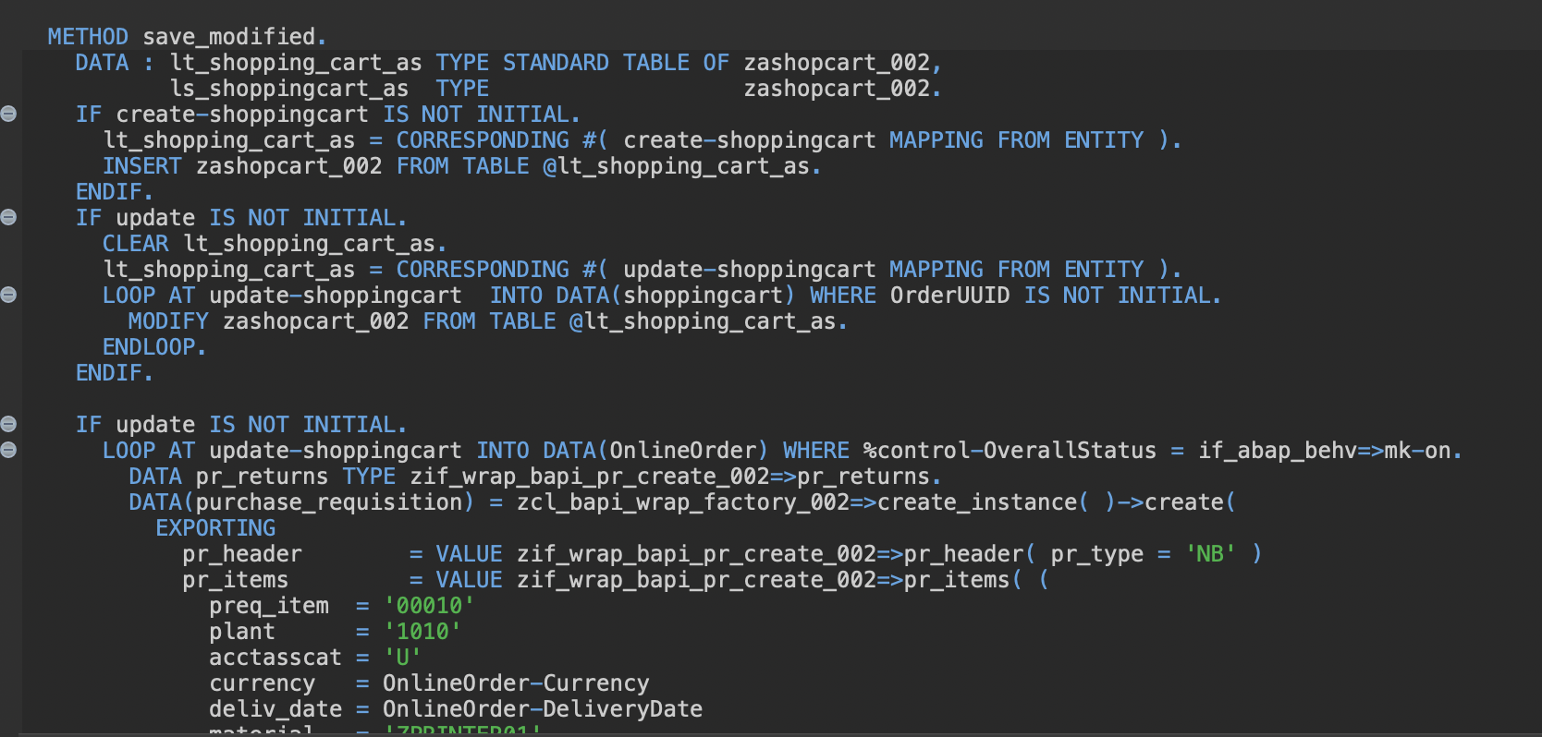
Implement unmanaged save

Slide 26
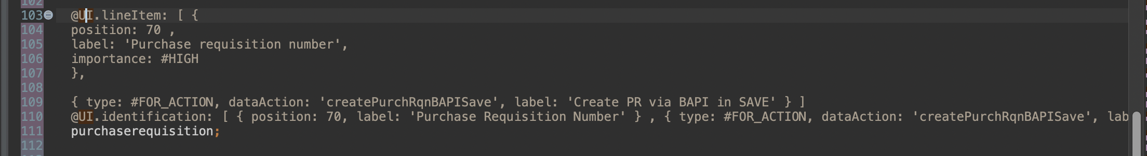
Expose the new action in Metadata Extension

Slide 27
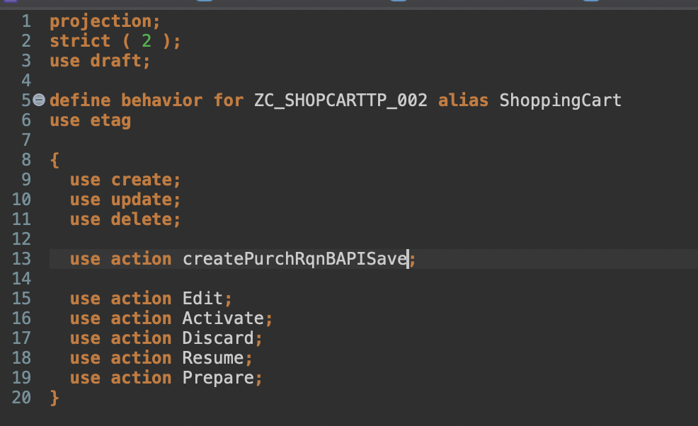
Expose the new action

Slide 28
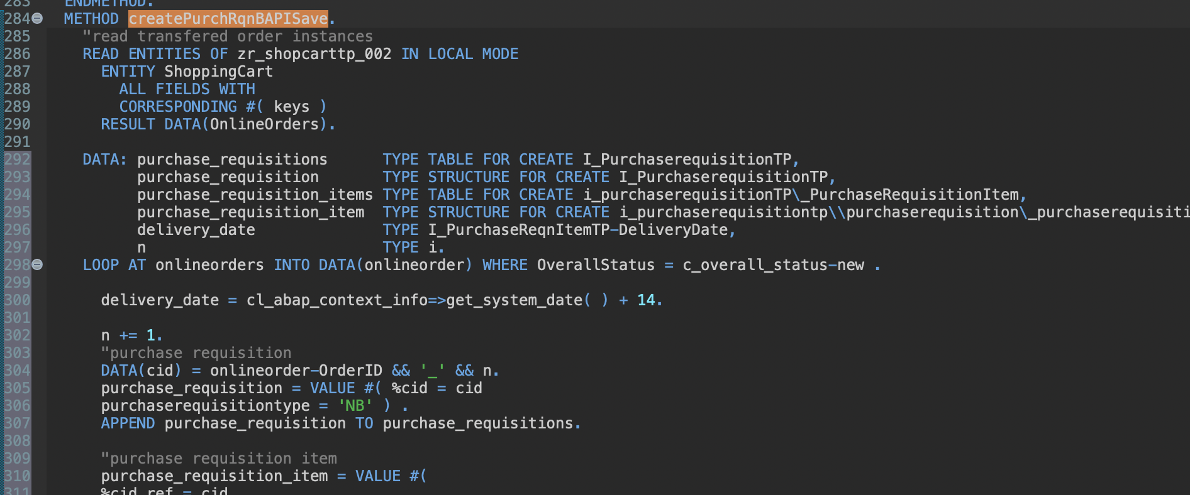
Replace Wrapper by API
Duplicate everything you need so that you have both codings.
Don‘t activate.

Slide 29
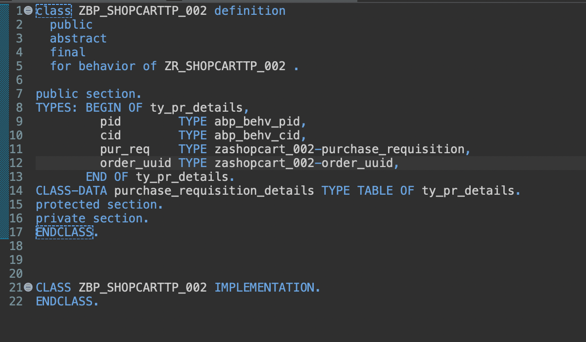
Replace Wrapper by API
Change your global class

Slide 30
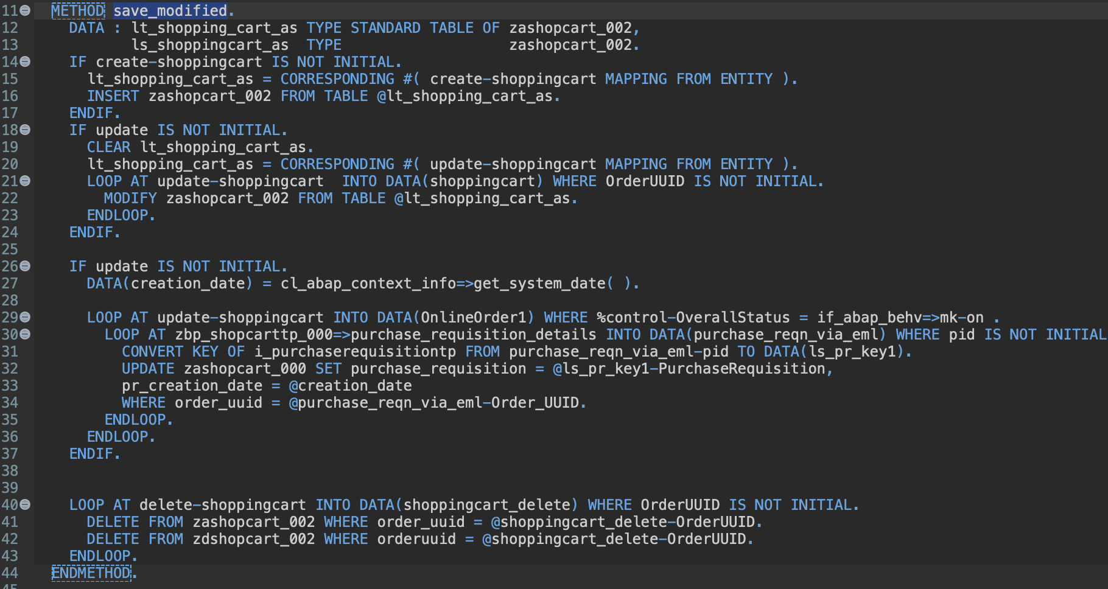
Replace Wrapper by API
Change save_modified.

Slide 31
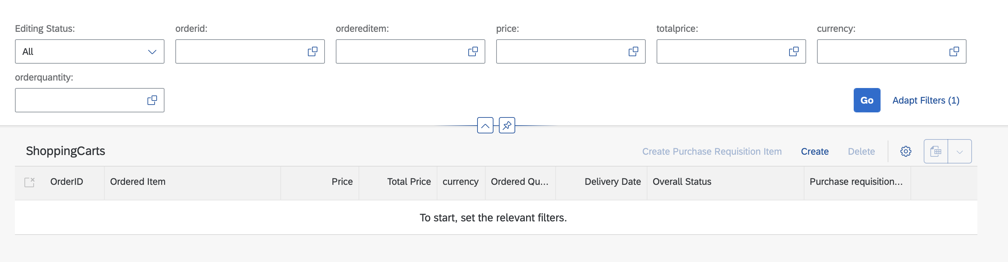
Extra Work I
Implement a selection

Slide 32
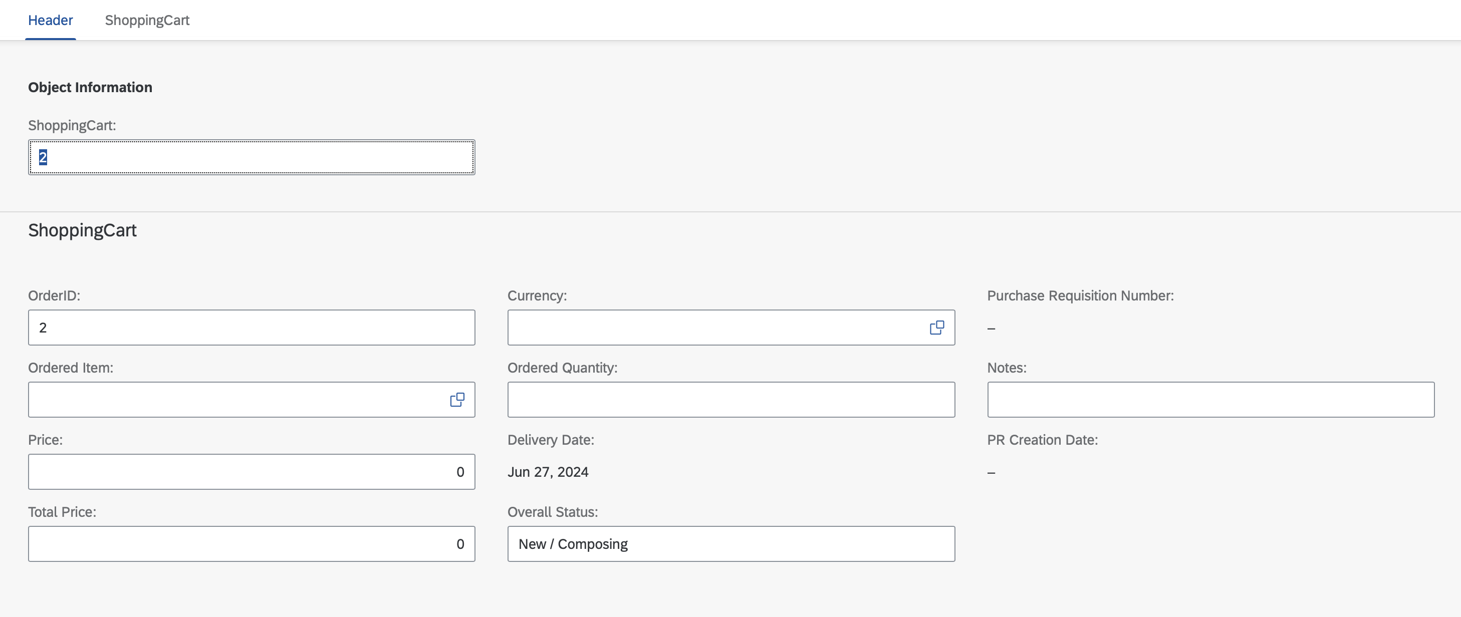
Extra Work I

Slide 33
Extra Work II
Try to create an app that uses an API.

